Slide 1

Artificial Intelligence Lecture 03: Agents Types
Farhad Muhammad Riaz

Slide 2
Lecture Outline
Agent types

Slide 3
Agents
An agent is anything that can be viewed as perceiving its environment through sensors and acting upon that environment through actuators
Human agent:
Eyes, ears, and other organs for sensors
Hands, legs, mouth, and other body parts for actuators
Robotic agent:
Cameras and infrared range finders for sensors
Various motors for actuators.

Slide 4
Agent types
Four basic types in order of increasing generality:
Simple Reflex agents
Model-based Reflex agents
Goal-based agents
Utility-based agents
And Finally: Learning agents

Slide 5
Simple Reflex Agents
The Simple reflex agents are the simplest agents.
These agents take decisions on the basis of the current percepts and ignore the rest of the percept history.
These agents only succeed in the fully observable environment.
The Simple reflex agent does not consider any part of percepts history during their decision and action process.
The Simple reflex agent works on Condition-action rule, which means it maps the current state to action. Such as a Room Cleaner agent, it works only if there is dirt in the room.
Problems for the simple reflex agent design approach:
They have very limited intelligence
They do not have knowledge of non-perceptual parts of the current state
Mostly too big to generate and to store.
Not adaptive to changes in the environment.

Slide 6
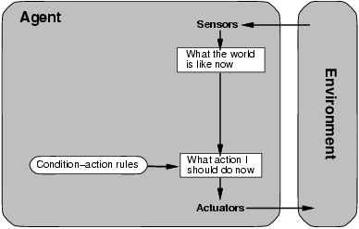
Simple Reflex Agents
Applies condition-action rules based only on the current input (reflex)

Slide 7
Simple Reflex agents
Automated Taxi:
Agent observes rain falling on the windshield: Agent powers on the viper
Agent observes a red signal; Agent breaks the taxi until it stops.

Slide 8
Model-based Reflex agents
The Model-based agent can work in a partially observable environment, and track the situation.
A model-based agent has two important factors:
Model: It is knowledge about "how things happen in the world," so it is called a Model-based agent.
Internal State: It is a representation of the current state based on percept history.
These agents have the model, "which is knowledge of the world" and based on the model they perform actions.
Updating the agent state requires information about:
How the world evolves
How the agent's action affects the world.

Slide 9
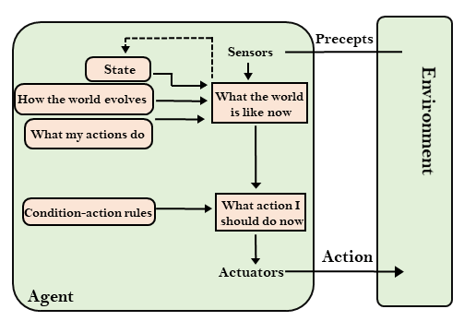
Model-based Reflex agents
Handles Partial Observability by creating a model

Slide 10
Model-based Reflex agents
Robo-Soccer Example:
Imagine a robotic goalkeeper
It can build a model of the dynamics of the game that is played on the field, e.g., when the ball is kicked in its direction, the ball will be nearer to it in the next time step
If this robot is not able to acquire its state at some time step, then using the model, it knows that the ball has come nearer
It also know what consequences a dive will have
So, it can time its dive early and hence, save the goal.

Slide 11
Goal-based agents
The knowledge of the current state environment is not always sufficient to decide for an agent to what to do.
The agent needs to know its goal which describes desirable situations.
Goal-based agents expand the capabilities of the model-based agent by having the "goal" information.
They choose an action, so that they can achieve the goal.
These agents may have to consider a long sequence of possible actions before deciding whether the goal is achieved or not. Such considerations of different scenario are called searching and planning, which makes an agent proactive.

Slide 12
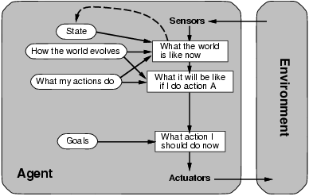
Goal-based agents
Along with the model, you need goals to direct the agent function.

Slide 13
Goal-based Agents
Automated Taxi:
Consider the agent at a crossing, where it can turn right, left, or go straight
Using the model, the Agent can understand the consequences of turning left, right or going straight ahead
All 3 might seem the optimal actions to take
However, the agent needs to select one of these actions in order to reach the destination of the passenger.

Slide 14
Utility-based agents
These agents are similar to the goal-based agent but provide an extra component of utility measurement which makes them different by providing a measure of success at a given state.
Utility-based agent act based not only goals but also the best way to achieve the goal.
The Utility-based agent is useful when there are multiple possible alternatives, and an agent has to choose in order to perform the best action.
The utility function maps each state to a real number to check how efficiently each action achieves the goals.

Slide 15
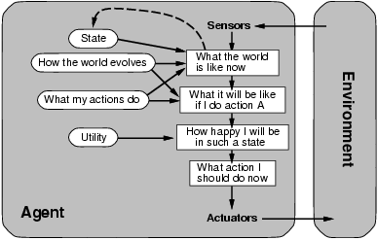
Utility-based agents
Solves the problem of conflicting goals, and quantifies the acquirement of goal

Slide 16
Utility-based Agent
Automated Taxi:
Consider the agent at a crossing, where it can turn right, left, or go straight
The agent will calculate the utility of each such action
It will select the action which maximizes the utility function, i.e., in most cases, the expected profit that the agent can expect to receive in the long run (when the passenger reaches the destination)
E.g., going straight could have highest utility.

Slide 17
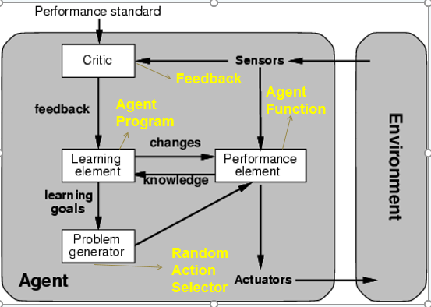
Learning Agents

Slide 18
What is SEARCH?
Suppose an agent can execute several actions immediately in a given state
It doesn’t know the utility of these actions
Then, for each action, it can execute a sequence of actions until it reaches the goal
The immediate action which has the best sequence (according to the performance measure) is then the solution
Finding this sequence of actions is called search, and the agent which does this is called the problem-solver.
NB: Its possible that some sequence might fail, e.g., getting stuck in an infinite loop, or unable to find the goal at all

Slide 19
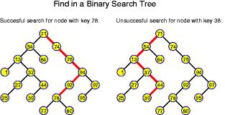
Linking Search to Trees
You can begin to visualize the concept of a graph
Searching along different paths of the graph until you reach the solution
The nodes can be considered congruous to the states
The whole graph can be the state space
The links can be congruous to the actions……

